Slide 1
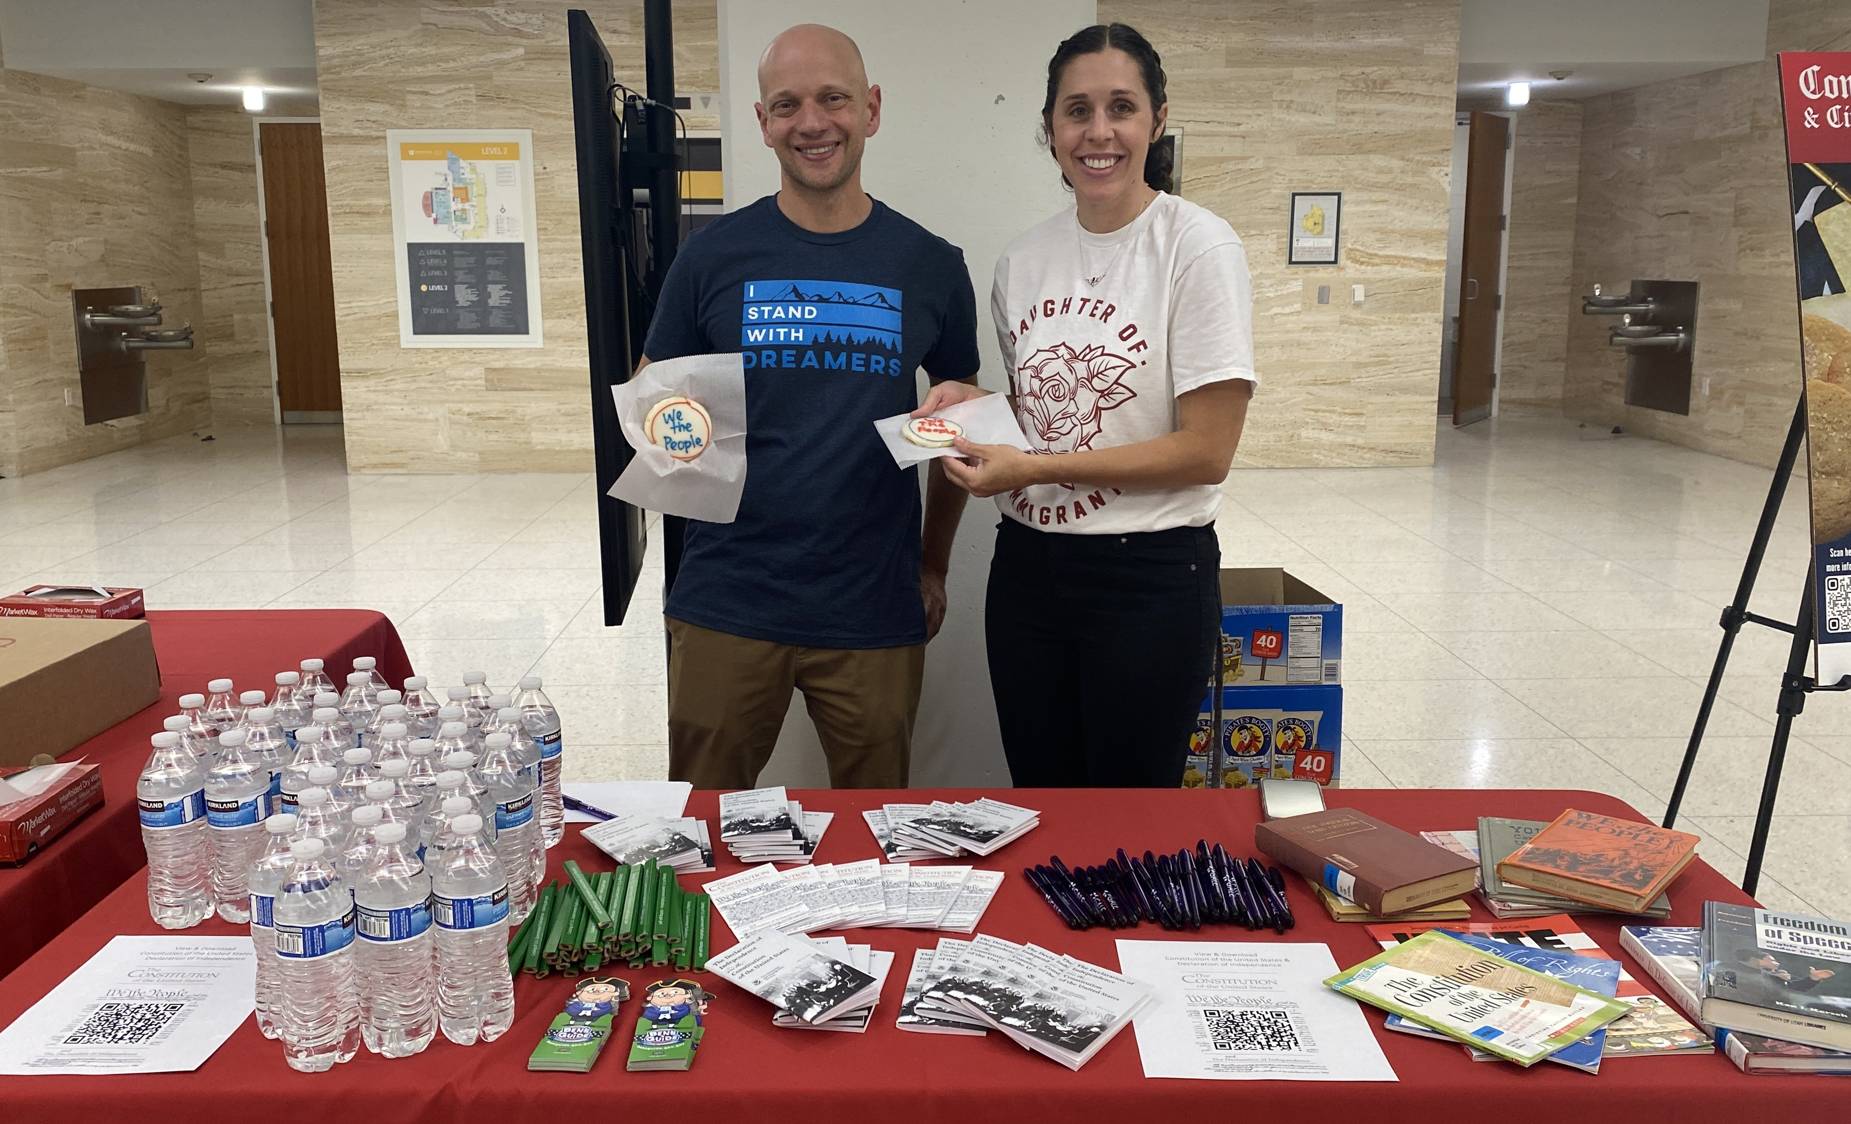
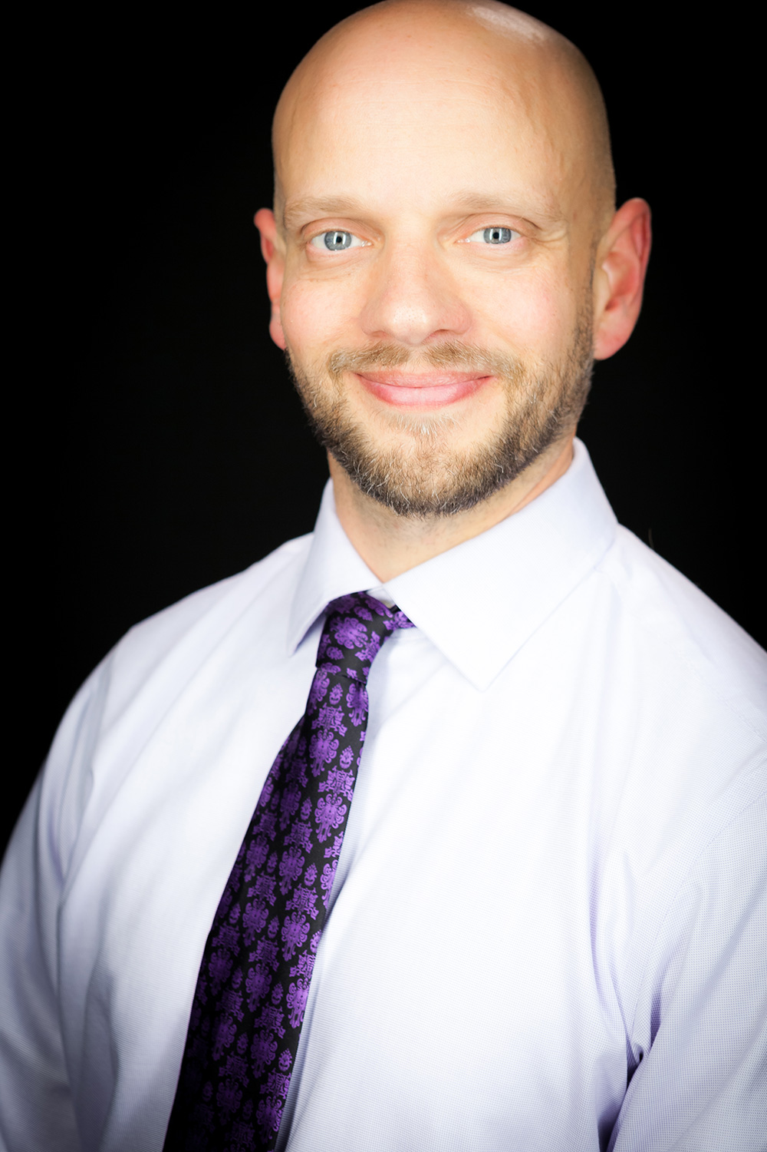
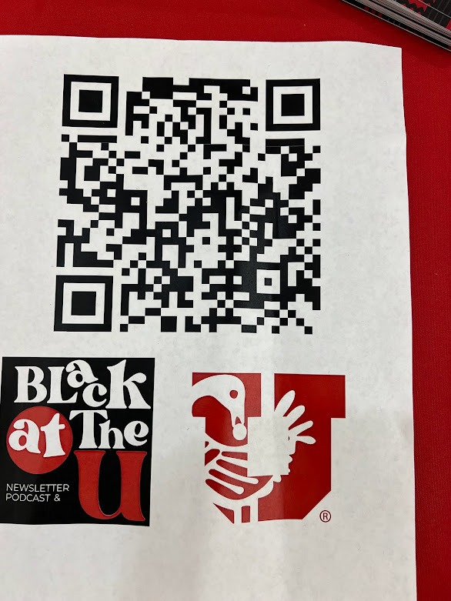
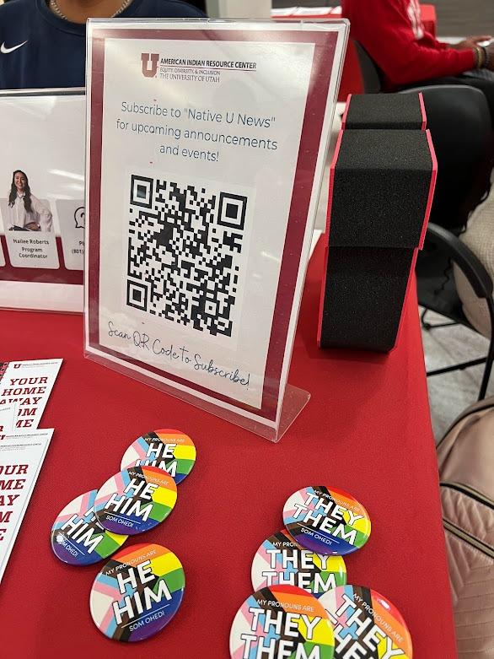
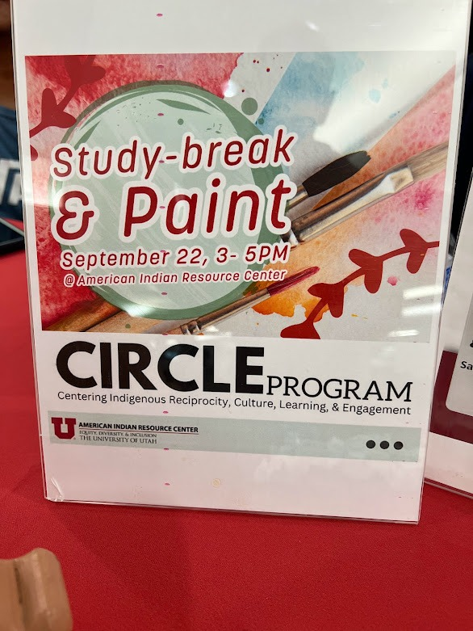
Celebrating
#ConstitutionDay and #CitizenshipDay
FDLP 2024
Conclusions
Value to individual students
Value to library
Value to citizenry
Constitutions, Cookies,
and Community.
Challenges
HB261, a recent Utah law, has introduced significant challenges to academic librarianship within the state. One primary concern is the potential impact on diverse student groups and how we connect them to resources.
The law's provisions, particularly those related to the teaching of critical race theory, could lead to a chilling effect on our ability to provide a comprehensive and inclusive learning environment. This could indirectly limit access to vital government information - particularly those related to controversial or sensitive topics - for marginalized student populations and hinder their academic success by hindering their ability to conduct research and understand the complexities of public policy issues.
At the UU, this has directly resulted in removing most student and community groups representing a specific population or identity way.
Shane Wallace and Ambra Gagliardi
Introduction
Constitution and Citizenship Day recognizes both the adoption of the United States Constitution and those who achieve citizenship. At the University of Utah (UU), the Government Documents team developed a plan to not only draw attention to the Constitution but to provide a forum for diverse student groups to gather and share information about citizenship.
A novel way of presenting the holiday: The celebration of the many ways of being a citizen
Methods
To realize our ambitions, we reserved a central, high-traffic location in the library for tabling. We pre-ordered 200 cookies frosted with "We the People" and unpacked our pocket constitutions supplied by the FDLP.
To make the tabling more meaningful beyond handing out free stuff, we focused on the citizenship aspect of the holiday. We invited three UU offices to table with us – the American Indian Resource Center, the Black Cultural Center, and the Dream Center (now First-Generation Scholars).
Giving voice to diverse campus groups on this federal holiday helped highlight our country’s complex history regarding citizenship, progress made, and work yet done—even if it was just a tabling event.
Futures
The Government Documents team at the UU will attempt to host a new version of the event in 2025, perhaps outside of the library.
Further Reading
More on HB261: https://le.utah.gov/~2024/bills/static/HB0261.html
Shane and Ambra preparing for the 2022 Constitution and Citizenship Day event.
W. Shane Wallace
University of Utah
J. Willard Marriot Library
shane.wallace@utah.edu
Results
Distributed all pocket constitutions and cookies and spread awareness of campus partners that serve marginalized members of the campus community.
Partners
Ambra Gagliardi
University of Utah
J. Willard Marriot Library
ambra.gagliardi@utah.edu
Black Cultural Center - https://blackculturalcenter.utah.edu/
First-Generation Scholars - https://firstgenscholars.utah.edu/
American Indian Resource Center (AIRC) - https://nativeexcellence.utah.edu/

