Slide 1
GPO on the Go: Condensed, Collaborative, Constructive Conversations
Jaime Hays
Outreach Librarian
GPO
jhays@gpo.gov
Notes:
I have visited 236 depository libraries.

Slide 2
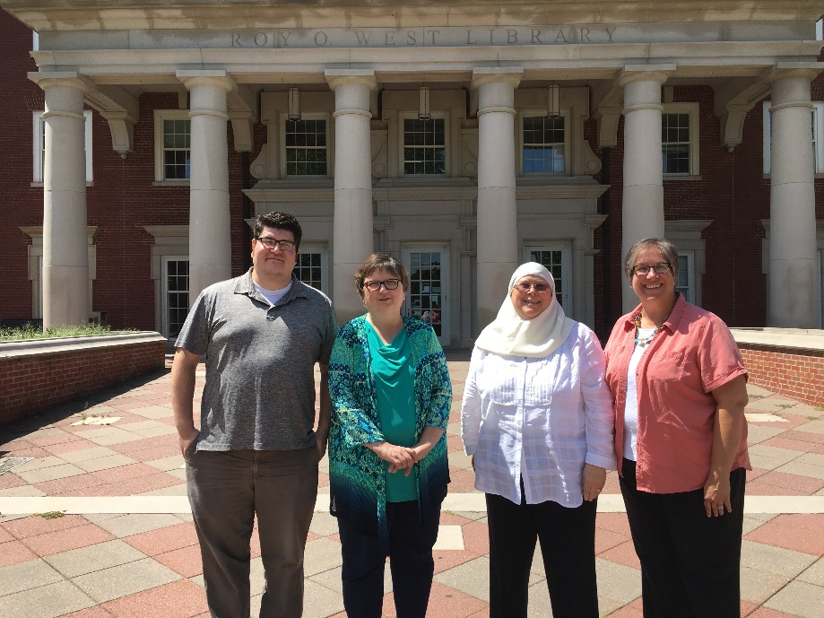
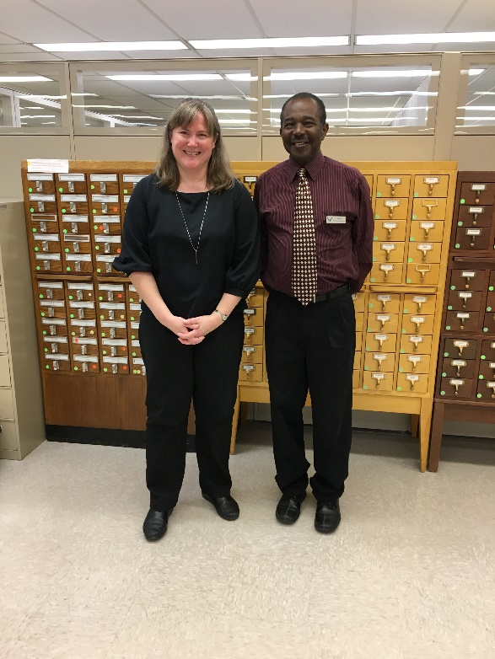
Overview
Why GPO visits a library.
How to prepare for a visit.
Regional impressions.
Outreach Librarian Kathy Bayer at the University of Alabama
Outreach Librarian Kathy Carmichael and Chief Robin Haun-Mohamed visit DePauw University in Indiana
Notes:
When going out to visit libraries, we noticed a trend. Many people feel uncomfortable with digital government documents. These questions are frequently asked during library visits. It is my goal that after this presentation you will be able to answer these questions.

Slide 3
Visits Described
Notes:
In the past the only time GPO would visit a library was to do an onsite inspection. GPO employees would show up at the library with a clipboard and conduct an assessment. So be aware that if your talking to library staff about a GPO visit some people we think back to these old inspections and they may be a bit nervous.
So you may be wondering why GPO is visiting depository libraries. This is part of our commitment to better support and engage with librarians and library staff at over 1,100 participating libraries in the Federal Depository Library Program (FDLP). When we visit libraries we get a better understanding of the issues and challenges that our libraries are facing. We learn about the unique cooperation among libraries. We see the unique collections that are in your libraries. We get fresh ideas for managing the FDLP and ideas for new webinars.
Here are some additional reasons we visit libraries-
By library request. This can be because the library has a new coordinator, they need advice, or they are celebrating an anniversary.
By regional request. Sometimes regional coordinators will invite us to visit libraries with them. When ever possible we try to have the regional with us during visits.
We are in the area. If GPO staff are in the area for a meeting or conference they may ask to visit.
Because we are trying to visit all the libraries in your state.
because we hear innovative things libraries are doing and want to see for ourselves. This can help us make sense of what new services GPO can develop to help libraries

Slide 4
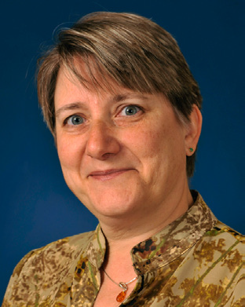
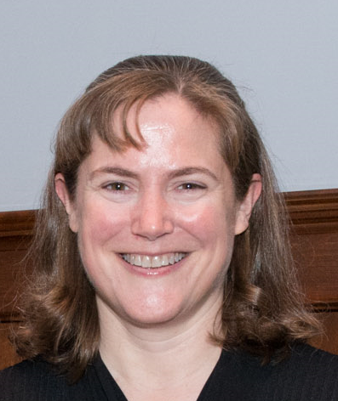
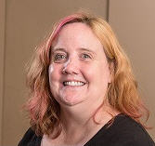
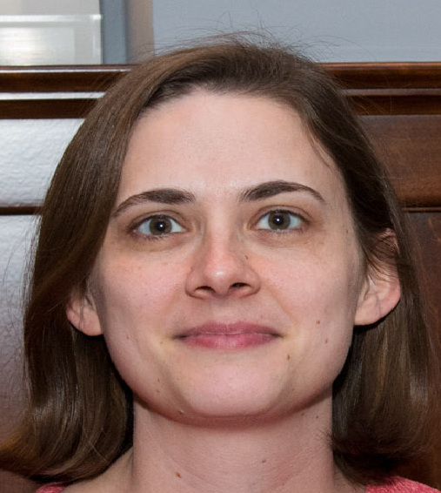
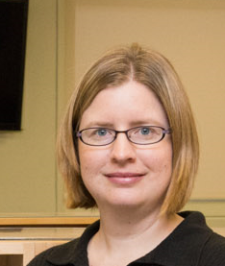
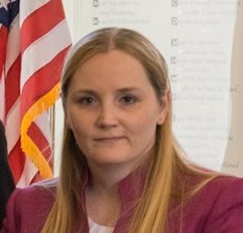
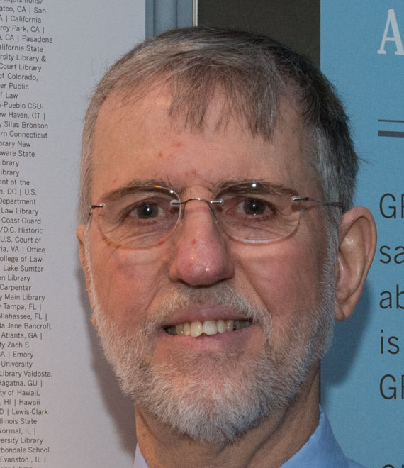
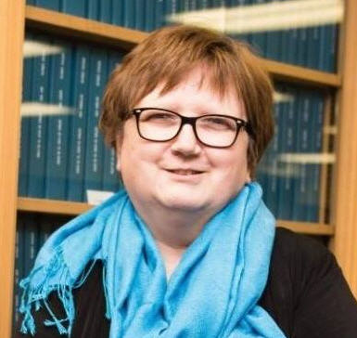
Library Services and Content Management, FDL Support Services
Top row: Laurie Hall, Superintendent of Documents; Kathy Bayer, Outreach Librarian, Manisha Bhattacharya, Administrative Librarian, Melissa Fairfield, Planning Specialist
Bottom Row: Outreach Librarians: Ashley Dahlen, Kathy Carmichael, Lara Flint, Jaime Hays, Joe Paskoski
Notes:
If your going to have a visit from someone at GPO it will most likely be from someone here. Although other GPO staff members do visit libraries from time to time.
Other members of LSCM and the executive team at GPO do make visits to libraries, so it is possible that you will receive a call or email from somone not on this slide.

Slide 5
Notes:
Ok so let’s talk about the elephant in the room that no one wants to talk about. What if you get a call from GPO about scheduling a visit, but you have some problems with your depository collection. Maybe you have some unprocessed boxes because you have had a vacant position for a while or you have cataloged tangible depository publications for 6 months because of a catalog migration. Perhaps you’re a new coordinator and the collection has been neglected for a while.
As these visits are not an assessment, there is no formal written report. If you are being visited by an outreach librarian, they can explain the rules and regulations and how to fix the issue you are facing.
If you are having a lot of issues or serious issues such as not providing public access we may offer to come back to do more extensive training with library staff. Usually our visits are shorter, but if your library has a need for a longer visit to work out issues we can make that happen.

Slide 6
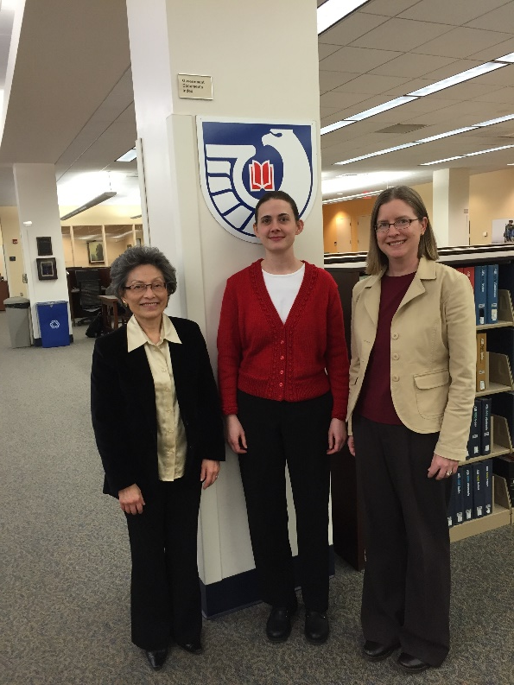
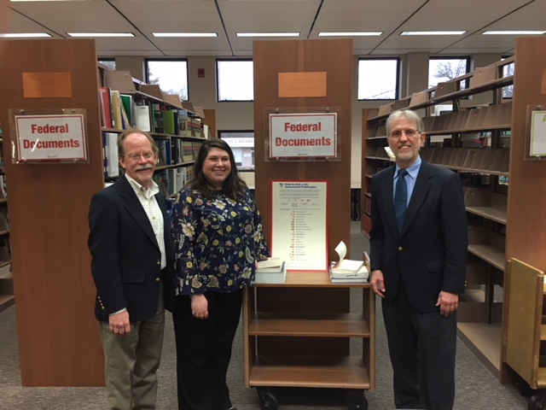
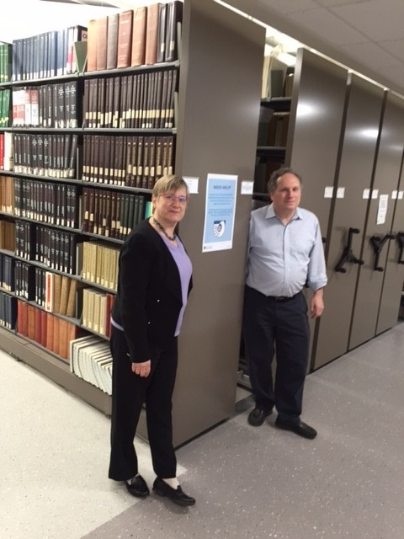
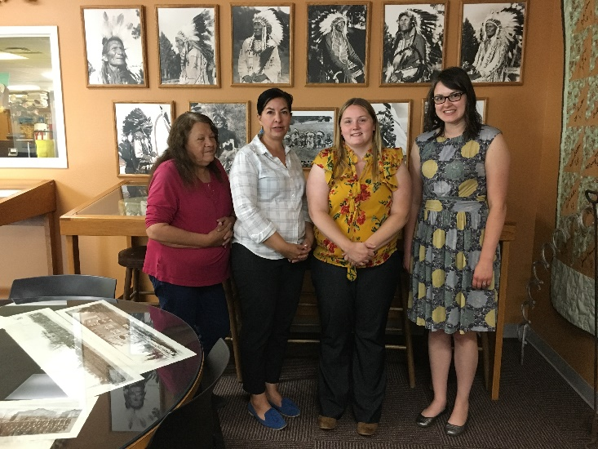
Visit Basics
0627 University of Vermont
0653 West Virginia University
0598 Longview Public Library in TX
0517B Oglala Lakota College in SD
Notes:
So here I want to describe the process of visiting depository libraries. The first thing we do at GPO is target an area for visits. I’ve already explained why we visit certain libraries and areas.
Once we have decided on the area to visit, we will contact the regional coordinator or coordinators. The purpose of the call or email is to let them know we are interested in visiting the area. We ask the regional if they would like to visit libraries with us. This largely depends on the funding available at the regional library. GPO does not pay for their visits, but often the regional will ride with GPO staff as we make visits around the state. We also determine the situation at the depository libraries. Are libraries in a renovation or is there a new coordinator? Things like that.
After communicating with the regional, the outreach librarian will reach out to the coordinators at each library they plan to visit. During the call the outreach librarian will explain who they are and that they want to visit. Usually there is very little wiggle room on date and time of the visit. This is because the outreach librarian maybe planning out a week long trip to as many as 10 libraries. If the coordinator is not available we may try to meet with other depository staff or a director. As we make it out to libraries so infrequently, we try not to miss an opportunity to visit when we are in the area. If visiting your library is not possible please let us know. We will try to visit the next time we are in the area, but it is not known when the next time will be.
When scheduling the visit we will ask to get a tour of the collection. If you have a physical collection we would like to see the collection. If your collection is integrated it is much more difficult to see the depository collection, but if you can show us some areas where there are documents it would be appreciated. We are also interested in seeing computers used for depository users, depository promotion, and processing areas. We also offer customized training for library staff. We can present the training for as many as 60 people or as few as 1. It makes no difference to us.

Slide 7
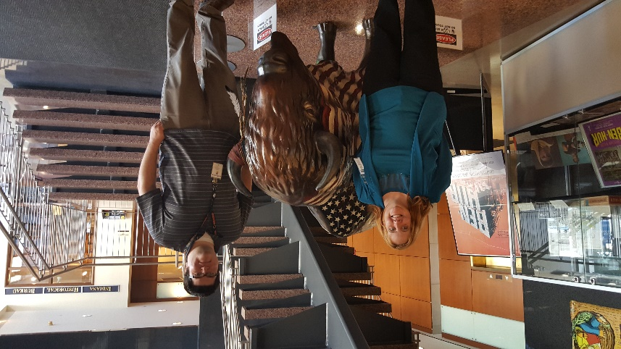
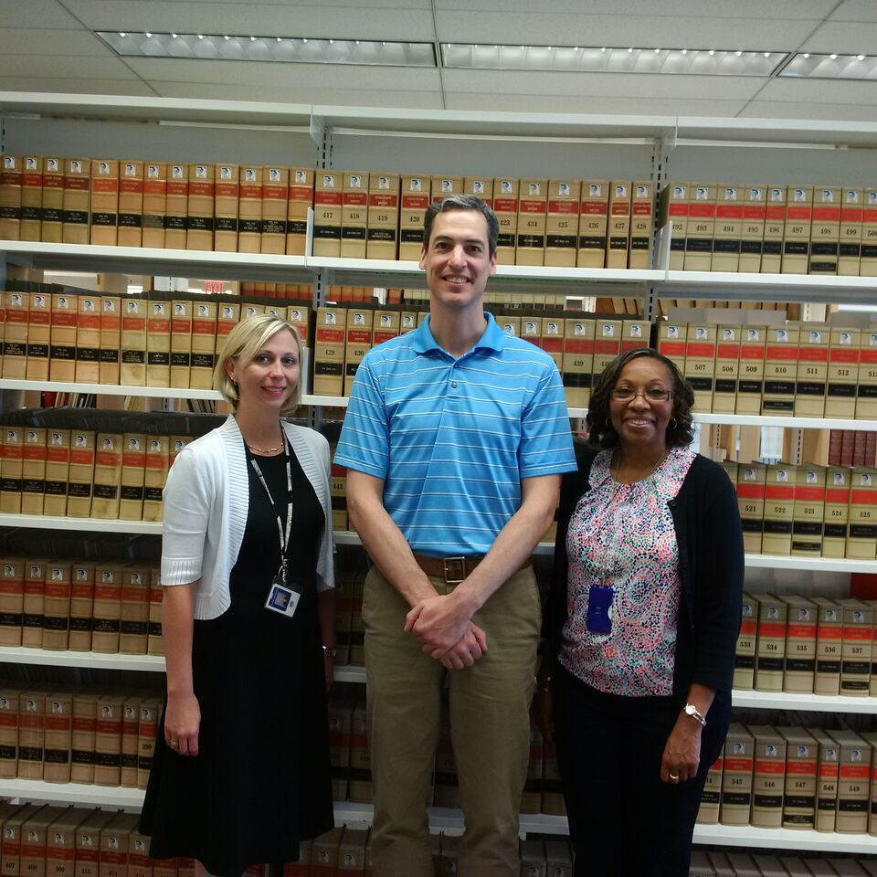
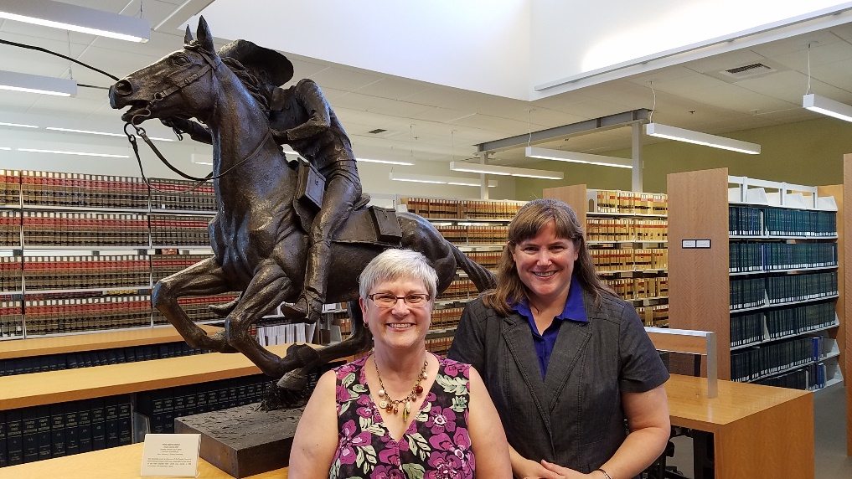
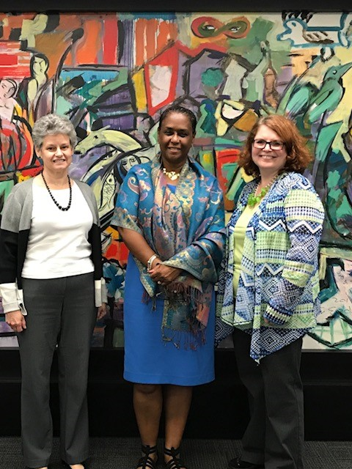
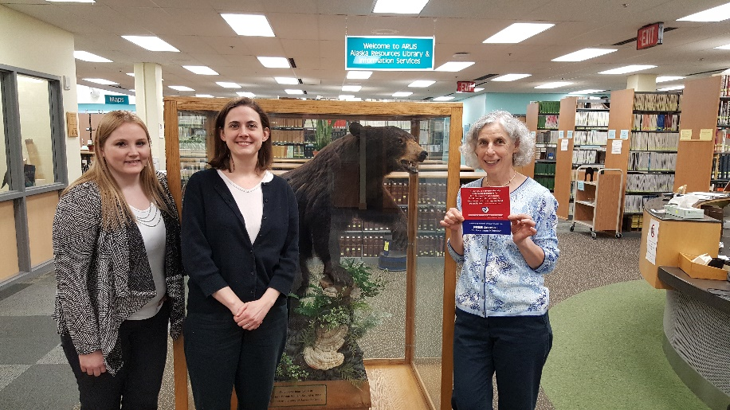
Visit Basics
0170 Indiana State Library
0413A U.S. Courts Library in NY
0060B University of the Pacific McGeorge School of Law in CA
0016B Alaska Resources Library & Information Services
0111A Florida Institute of Technology
Notes:
Typically we give about a month’s notice of a visit. In that time there maybe some back and forth as arrangements are made. It would be very helpful to provide the outreach librarian with a campus map and information on parking. Also if navigating in the area is difficult because of construction, your campus lacks signage, or your library location is wrong in google maps, please let us know.
This is a good time to ask about any questions you may have. One question I get is how to prepare. Do you need to prepare a self-study before the visit? It is not required, but completing a self-study might help you to answer questions when GPO staff members come to visit. I would recommend being prepared to answer basic questions about your depository collection. For example, where is it, who uses it, how do you promote it, how do you catalog tangible and digital depository resources?
About a week prior to the visit we will reach out and touch base again to make sure the visit is on and to ensure we have correct addresses and parking in formation. We will also give you our work cell phone numbers. If there is any need to contact us the week of the visit calling the work cell phone is your best bet. Although as we are visiting other libraries and traveling you may need to leave a message.
During the visit we try to arrive a few minutes early to make sure we are on time and also to take pictures of the library building. During the visit we will also ask to take a photo with depository staff. GPO likes to post pictures of these visits to social media platforms such as facebook and twitter. When choosing a location we tell coordinators to pick something you are proud of, something unique or interesting, or something that says the library’s name. The photo does not have to be connected to the FDLP. Taking photos in front of windows or glass cases can be difficult as it bounces light so we try to avoid those photos.

Slide 8
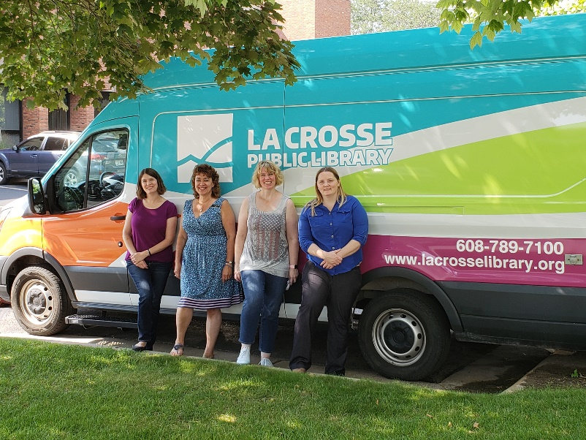
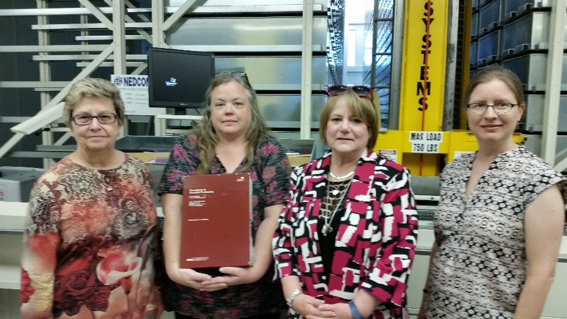
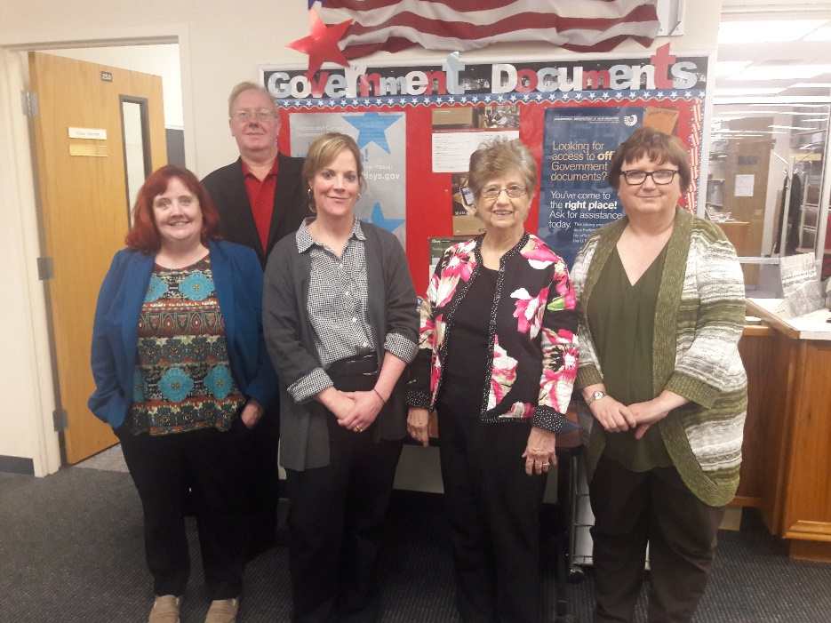
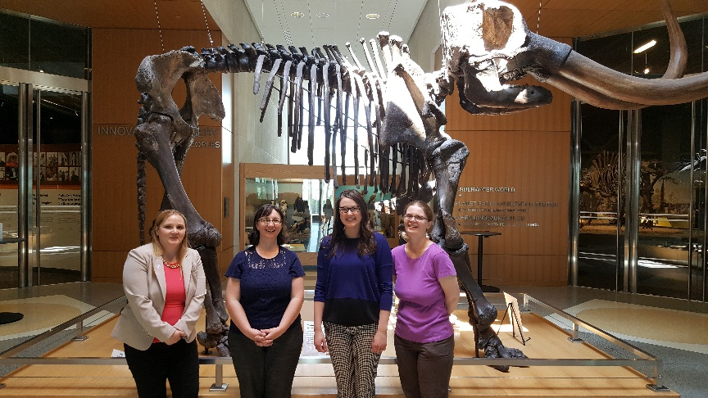
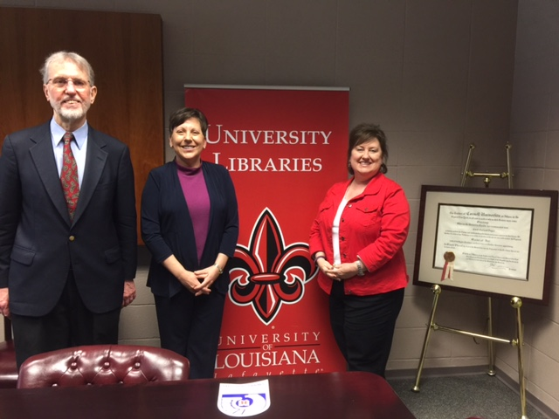
Visit Basics
0211 University of Louisville in Kentucky
0669 La Crosse Public Library in WI
0594A Dallas Baptist University in TX
0228 University of Louisiana at Lafayette in Louisiana
0457 State Historical Society of North Dakota
Notes:
The visit lasts anywhere from 1 hour to 4 hours. It really depends on the needs of the library. Some libraries request a lot of training others just want an informal chat about depositories issues. If requested training this is the time we would provide it. Having a computer and someway to project power point slides is very helpful. We typically will have our presentation on a power point slide.
During this time period we can give you customized advice about what issues your depository is facing.

Slide 9
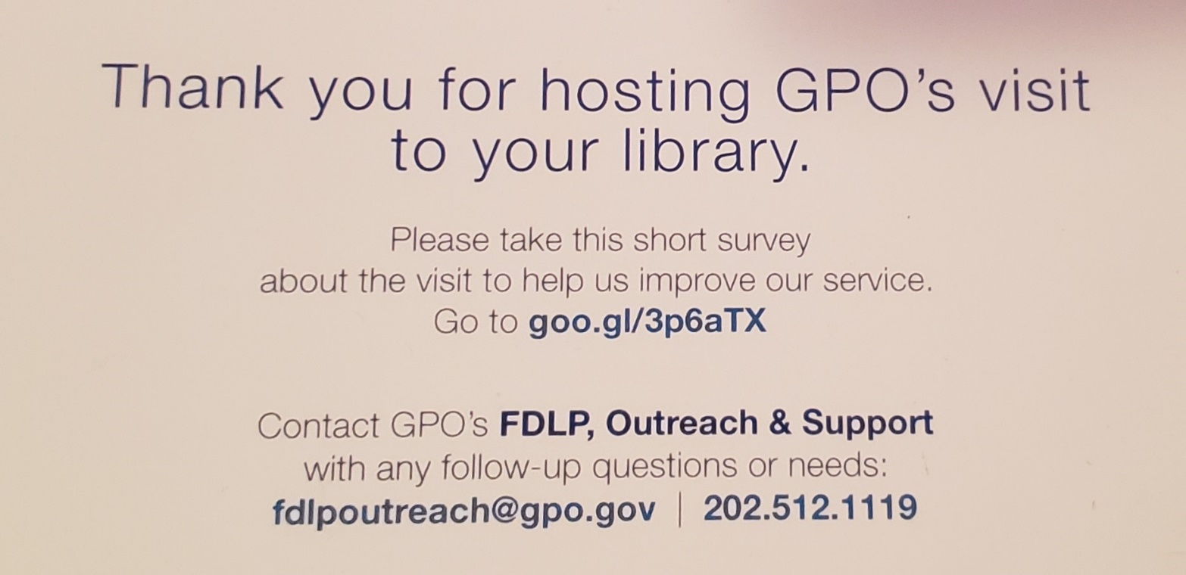
Notes:
As this is a new type of visit for GPO, we are trying to determine if these visits are helpful. So after a visit you may receive one of these cards or be asked to take a survey. We use this data to determine if our visits to the libraries are beneficial. We also use written comments to help make changes to the visits.

Slide 10
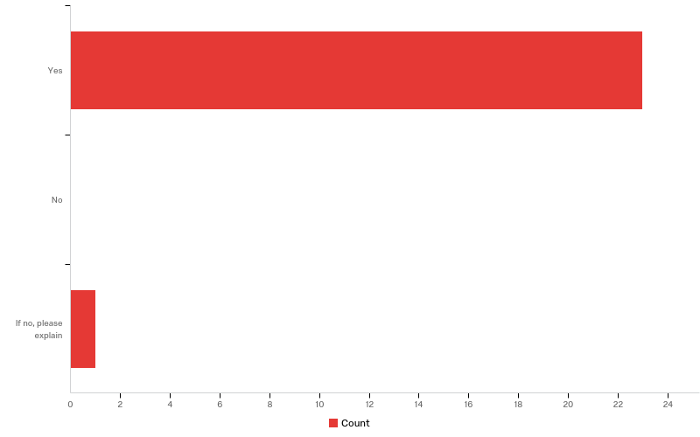
Did the visit scheduling process accommodate your needs and run smoothly?

Slide 11
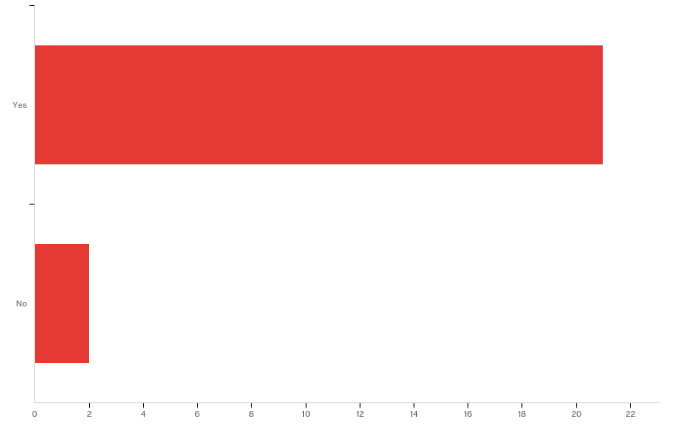
Were all the questions you had during or after the visit answered to your satisfaction by GPO? Please explain as needed.
Notes:
One said they wanted more time and the other was waiting for follow-up from GPO.

Slide 12
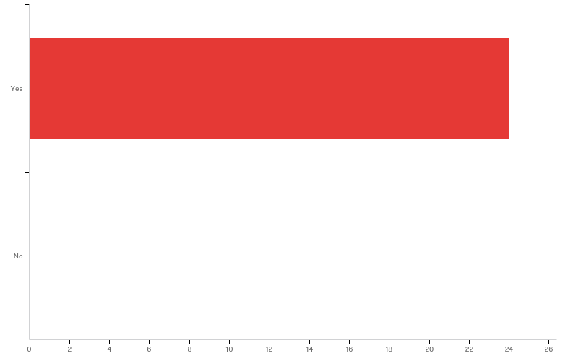
Was the visit beneficial? Please explain as needed.

Slide 13
Was the visit beneficial?
Though we did not have a lot of time to devote tot he visit, It was reassuring to learn that other libraries are experiencing the same challenges we are with government documents and the collection in general (how to right-size) and to see how Libguides could benefit us.
Very helpful! Hands-on practice with FDLP eXchange helped us all feel more comfortable about using the tool.
Both myself and the other staff member who work with government documents are new to the positions (1 year and less than 1 year respectively) and we felt that this was a great opportunity to expand our knowledge of what we should and shouldn't be doing, as well as learning about tools to make our workflow more efficient. We feel much more confident in our positions after this visit and training.
Training was tailored to our specific situation, and several staff were able to participate. Our Regional coordinator also attended, which was very helpful.
It was very timely, as we are moving toward a more "electronic" depository. It helped clarify some of the process. It was very useful to get insight from the GPO librarian's on this transition, as well as some input about other libraries in our state that are doing the same thing and that we could network with for shared experiences. They also gave us a better knowledge of the Stewardship Program, so we are considering doing something for that.
I found the feedback received about what we are doing well as a selective and areas in need of improvement extremely valuable.
Notes:
No one answered that the visit was not beneficial.

Slide 14
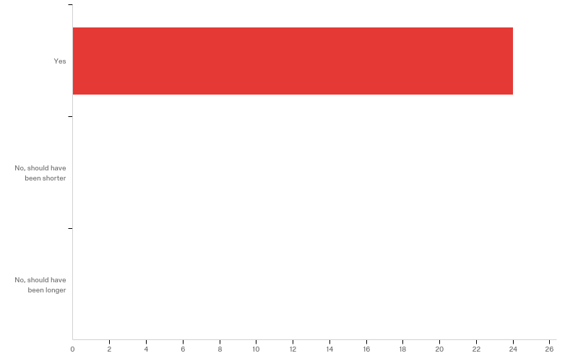
Was the length of time of the visit appropriate?
Notes:
Typically our visits last anywhere from 1-4 hours. It depends upon a variety of factors such as availability of staff at the library, if training is requested, and how extensive conversations run.

Slide 15
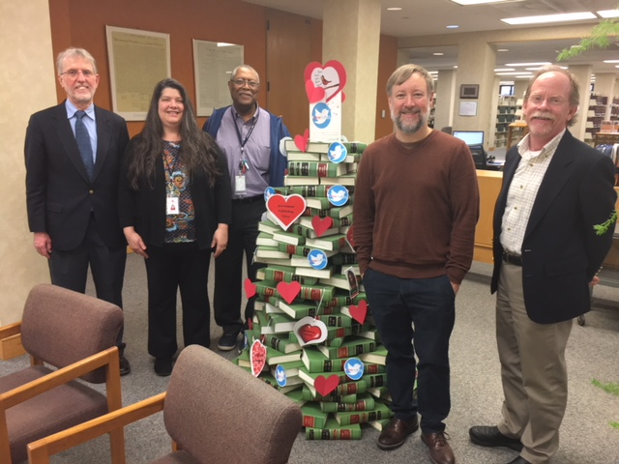
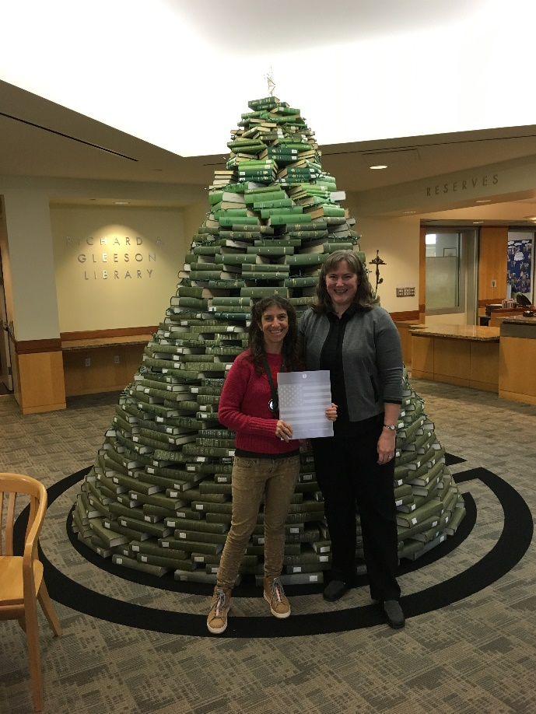
Post Visit
Federal Depository Support Services
202-512-1119
fdlpoutreach@gpo.gov
0229 Shreve Memorial Library in Louisiana
0044C University of San Francisco in California
Notes:
After the visit is over the outreach librarian will provide additional follow-up. Every outreach librarian handles the follow up a little differently. But generally, the director and the coordinator will receive a thank you letter. The outreach librarian will also provide any follow-up that was promised. This can be providing links to information that was talked, providing copies of reports, or finding answers to questions that were asked during the visit.

